Slide 1
Application Prototype for Centralized and Automated Network Management System
Petar Kresoja
Marko Šarac
Aleksa Vidaković
Teodor Petrović
Miloš Mravik
Novi Sad
2025

Slide 2
Introduction
Modern networks require unified, automated management.
Existing solutions often lack integration and automation.
Aim: Develop Spectra, a centralized and automated system for network control and monitoring.
Novi Sad
2025

Slide 3
Problem Statement
Manual network management is error-prone and time-consuming.
Lack of centralized control and unified interface.
Growing complexity of network infrastructures requires modern solutions.
Novi Sad
2025

Slide 4
Objectives
Design and implement a prototype of a centralized network management application.
Provide an intuitive user interface and automated backend operations.
Improve network visibility and reduce manual configuration.
Novi Sad
2025

Slide 5
Methodology
Tools used: TypeScript + Express and TypeScript + Vue 3.
Backend development with RESTful APIs.
Modular system architecture for scalability and flexibility.
Novi Sad
2025

Slide 6
System Architecture
Frontend: Web-based user interface (Vue 3+ Bootstrap).
Backend: Express TypeScript framework with API endpoints.
Database: MySQL – stores device data, logs, and configurations.
Real-time data exchange enabled via AJAX and JSON.
Novi Sad
2025

Slide 7
Key Features
Device discovery and registration.
Centralized monitoring of device status and logs.
Automated alerts for network anomalies.
User management and role-based access control.
Novi Sad
2025

Slide 8
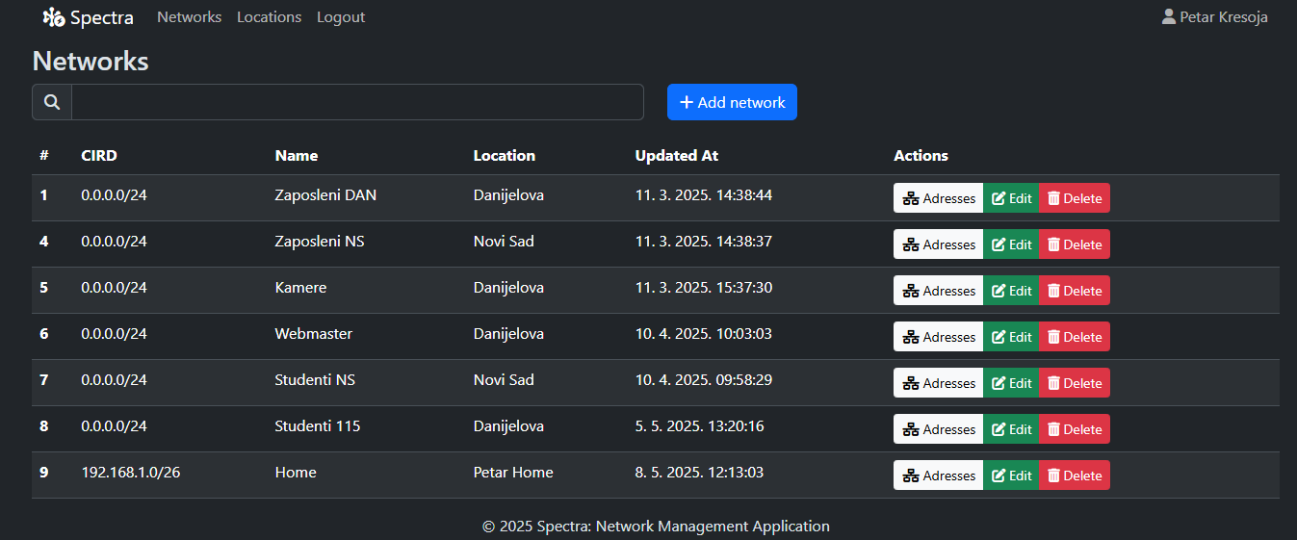
Prototype Screenshots
Novi Sad
2025

Slide 9
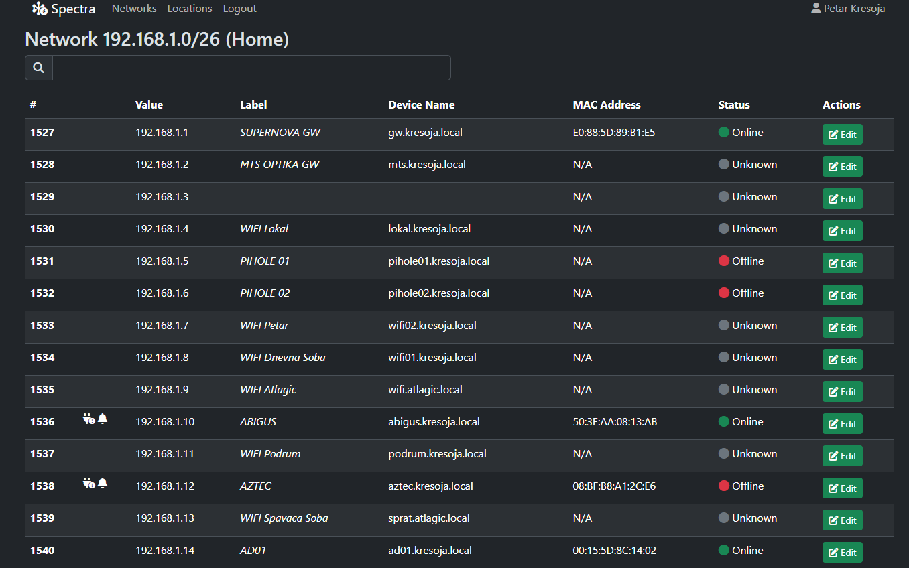
Prototype Screenshots
Novi Sad
2025

Slide 10
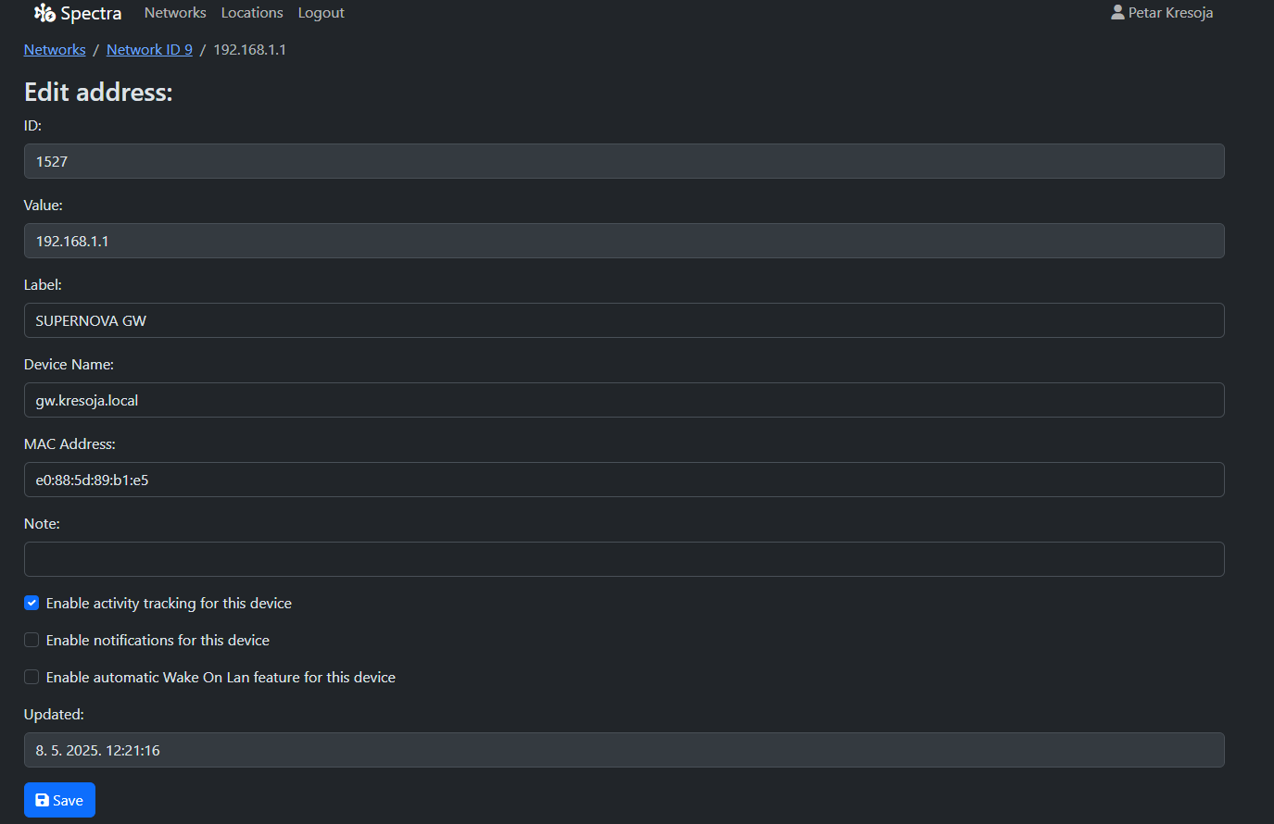
Prototype Screenshots
Novi Sad
2025

Slide 11
Results & Benefits
Successful creation of a functional prototype.
Streamlined monitoring and management tasks.
Reduced manual errors and increased responsiveness.
Scalable and adaptable for real-world environments.
Novi Sad
2025

Slide 12
Conclusion & Future Work
Conclusion: Spectra demonstrates the potential of centralized network management.
Future Work:
  Integrate AI for predictive maintenance.
  Extend device compatibility.
  Cloud-based deployment for wider access.
Novi Sad
2025

